Slide 1
Introducing Classes
Modelling the real world in code

Slide 2
A Note on Programming Styles
  Up until now we have used procedural programming
    Action-driven
    Call procedures (functions) to carry out actions
    Everything is about steps/logic to be done, not about data to be worked with
  Another programming style is object-oriented programming
    Data-driven
    Data is bundled in objects
    Objects have abilities (methods) they can perform on their own data

Slide 3
Introducing Objects and Classes
  Objects are a way to bind together multiple data fields (attributes) and corresponding abilities (methods)
    There can be an infinite* number of objects of any type in your program
  Classes are a blueprint for how these objects are structured
    The class defines the attributes and methods for all objects of that type
    Each object can insert its own information into its copies of the attributes

Slide 4
Let’s Build a House
  To define what a house looks like in our code, we would create a House class
  House class would state what kind of things are inside the house, e.g.:
    Window type
    Number of rooms
    Colour
    Etc
  To build a house, we would then make a House object
    Give a value to each of the things the class lists, e.g. bay for the window type, 10 for the number of rooms
Blueprint for the overall shape of any possible House

Slide 5
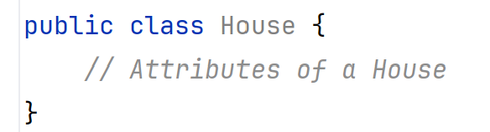
Defining a House class:
The Blueprint for all Houses
  Defining the House class gives us a blueprint for all House objects in our code
  We define a class using the class keyword:
  class marks the block of code as a class
  The code within the class defines:
    What is stored by that class
    What that class can do
Signature of the class

Slide 6
A Note on Class Names and
Naming Conventions
  Class names should be nouns
    The name of the entity being modelled in code
    Usually singular, unless you are storing data on multiple entities in one object
  Classes do not follow the same naming conventions we’ve used up to now!
    We always start a class name with an uppercase letter
    We do not use _ in class names
    Where there is more than one word in the name of the class, we use cap case:
      The class name is still all one word (no spaces allowed)
      There is an uppercase letter at the start of each new word within the name

Slide 7
Exercise: Good vs Bad Class Names
  house
  Address
  Customer_Data
  Houses
  Car
  furniture
  Buildingblock
  Orders
  Loaning
  motorFactory
Which of these are good options for names?
Which are unsuitable?

Slide 8
Good Class Names!
  house
  Address
  Customer_Data
  Houses
  Car
  furniture
  Buildingblock
  Orders
  Loaning
  motorFactory
These are very clear class names and are in line with Java’s naming conventions

Slide 9
Bad Class Names: Verbs
  house
  Address
  Customer_Data
  Houses
  Car
  furniture
  Buildingblock
  Orders
  Loaning
  motorFactory
Name is a verb, not a noun

Slide 10
Bad Class Names: Underscores
  house
  Address
  Customer_Data
  Houses
  Car
  furniture
  Buildingblock
  Orders
  Loaning
  motorFactory
Name uses an underscore to separate component words

Slide 11
Bad Class Names: Not CapWords
  house
  Address
  Customer_Data
  Houses
  Car
  furniture
  Buildingblock
  Orders
  Loaning
  motorFactory
Name/Internal word starts with a lowercase letter

Slide 12
Troublesome Class Names
  house
  Address
  Customer_Data
  Houses
  Car
  furniture
  Buildingblock
  Orders
  Loaning
  motorFactory
These end in “s”
This is only ok if there is somehow a way for a single instance of this to store data on multiple of this type.
Usually this is a variable name, not a class name. It would be used for a collection (e.g. list, dictionary, tuple) of that type of entity

Slide 13
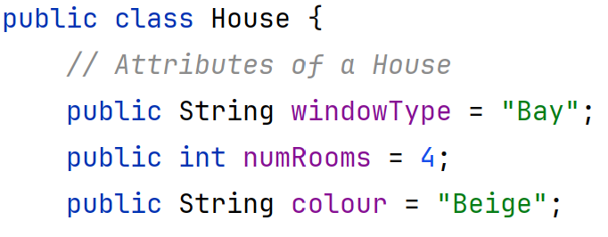
Inserting Attributes:
Adding Detail to the House
  We can define what information is included about a House (its state) by adding attributes to the class
    Attribute: A variable within the class not defined within a method
  Attributes are defined at the top of the class
    Should appear directly underneath the class signature
  We can give each attribute a default value when we define it
Now every house has bay windows!
Full code: slide_examples/introducing_classes/entities/House.java

Slide 14

Terminology Check:
Instances and Attributes
  Instance: a single copy of a class
    An object built using that class’s structure/blueprint
  Each instance contains its own set of attributes
    These are known as instance variables
  Instance variables are not shared
    Each instance variable belongs to a specific instance
    If houseA changes its colour, houseB won’t be affected

Slide 15
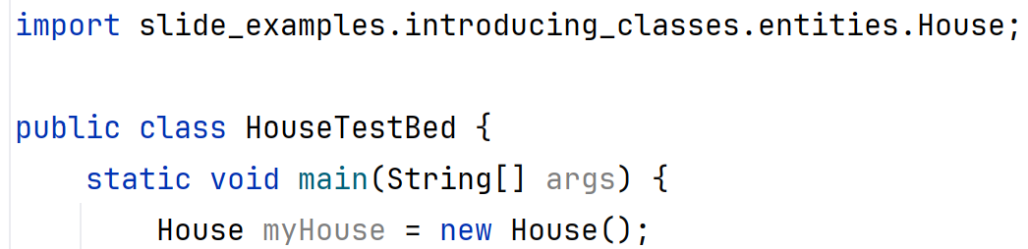
Creating an Instance:
Building a House in our Code
  House class defines a new type in Java
    We can use that type to store and work with information just as we do int, double, String, ArrayList etc
  To make a House object/instance in our code, we need to:
    Import the class (classes are built in their own individual files, one for each class)
    Create a variable of that type using the name of the class:
Full code: slide_examples/introducing_classes/apps/HouseTestBed.java

Slide 16
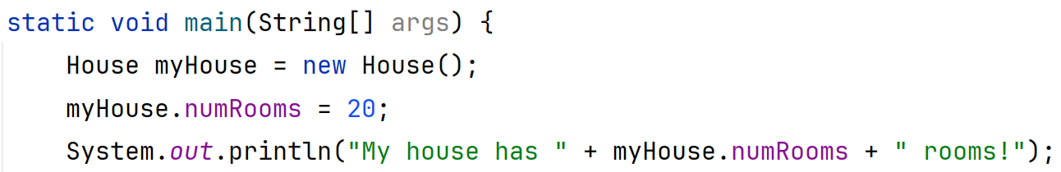
Changing Attributes:
Customising Our House
  Problem: The information inside the house isn’t changing
    Blueprint should define the general shape
    Details should be able to change
  To change the details of a House, we can reset them
    We do this using object_name.attribute_name
Same notation to access/view information!
slide_examples/introducing_classes/apps/HouseTestBed.java

Slide 17


Behaviour and Classes:
Introducing Methods
  Classes dictate a class’s attributes
    What information can be stored (its state); its variables
  Classes also dictate a class’s behaviour
    What that class can DO; its methods
  Usually no static keyword in the method signature
    We’re currently dealing with instance methods – one copy for each object
    We’ll revisit static later…

Slide 18
When We Use static
  static makes things shared
    Each object shares a SINGLE copy
House:
public static void display()
windowType = “Bay”
numRooms = 20
colour = “Blue”
windowType = “Picture”
numRooms = 10
colour = “Orange”
house1
house2
House house1 = new House();
house1.windowType = “Bay”
house1.numRooms = 20
house1.colour = “Blue”
house1.display()
House house2 = new House();
house2.windowType = “Picture”
house2.numRooms = 10
house2.colour = “Orange”
house2.display()

Slide 19
When We DON’T Use static
  Leaving out static makes an instance method
    Each object has its OWN copy
windowType = “Bay”
numRooms = 20
colour = “Blue”
public void display()
windowType = “Picture”
numRooms = 10
colour = “Orange”
public void display()
house1
house2
House house1 = new House();
house1.windowType = “Bay”
house1.numRooms = 20
house1.colour = “Blue”
house1.display()
House house2 = new House();
house2.windowType = “Picture”
house2.numRooms = 10
house2.colour = “Orange”
house2.display()

Slide 20
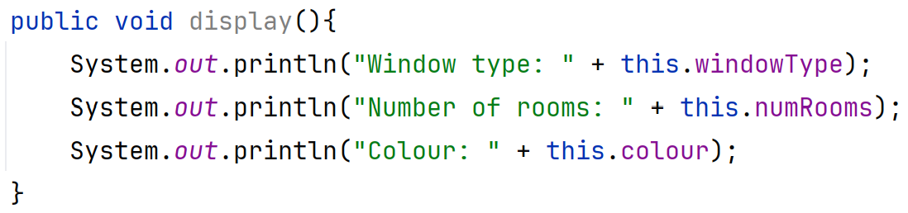
Adding Behaviour:
Including Methods in our House
  Instance methods (methods belonging to an object, i.e. NOT static methods) are written in the same way as any other methods
    Must include a name and a return type
    MAY have parameters
  We can use the this keyword to indicate we’re using an instance variable
    Syntax: this.numRooms: the numRooms belonging to THIS (the current) instance
slide_examples/introducing_classes/entities/House.java

Slide 21
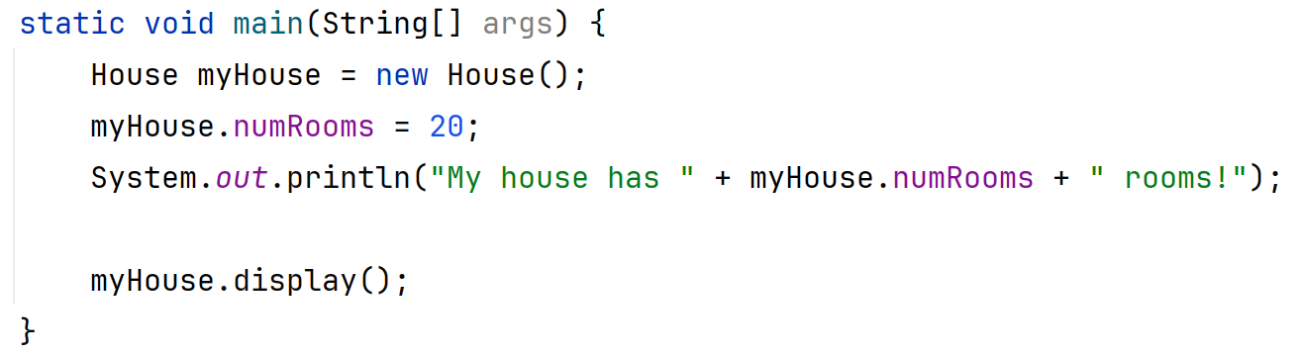
Using Behaviour:
Calling a Method on an Object
  To call a specific method, we state:
    What method should be run
    Which object/instance should run it
slide_examples/introducing_classes/apps/HouseTestBed.java

Slide 22
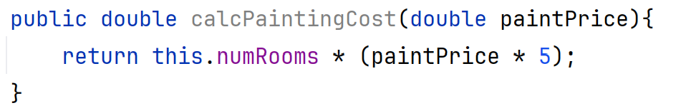
Including Parameterized Behaviour:
Customising the Behaviour
  As with standard methods, we can include parameters in our instance methods:
  We can use this method with our object and supply the specified parameter as normal:
slide_examples/introducing_classes/entities/House.java
slide_examples/introducing_classes/apps/HouseTestBed.java

